Slide 1
Software Requirements Specification
OKR Module of Neutrino

Slide 2
01_ Introduction

Slide 3

Rock IT’s Mission and Vision:
Effortless technology that is Solid, Simple & Secure

Slide 4

Neutrino.
A “whole of business” platform providing a clear line of sight for Rock IT across:
Strategy
Financials
Systems
Performance

Slide 5

OKRs.
Objectives & Key Results
A technique for setting and communicating goals and results

Slide 6
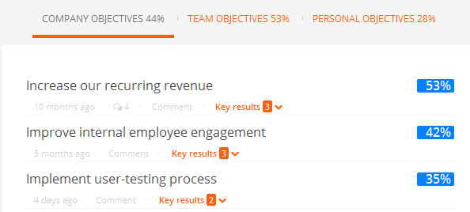
Objectives
Quarterly (3-5 on company, team or personal levels)
Qualitative
Actionable
Aspirational

Slide 7
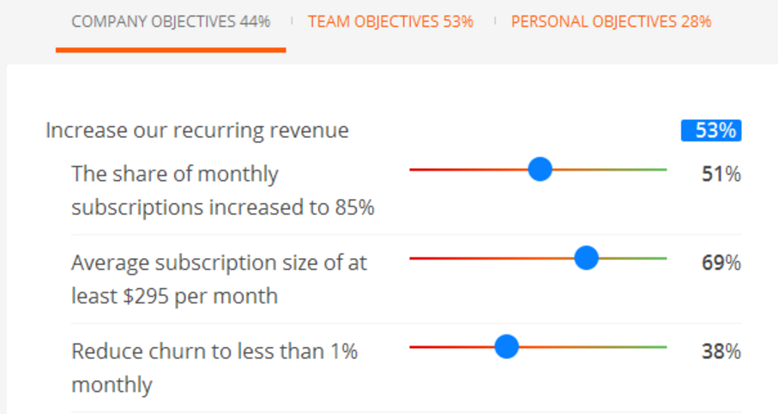
Key Results
Must be measureable (3-4 per objective)
Measureable (pass mark is ~70%)

Slide 8
Key Results
Must be measureable (3-4 per objective)
Measureable (pass mark is ~70%)

Slide 9
OKR cascading flow
Full transparency across all levels and indivduals
Company
Sales
Person A
Person B
Operations
Person n
Company OKRs
Team OKRs
Individual OKRS

Slide 10
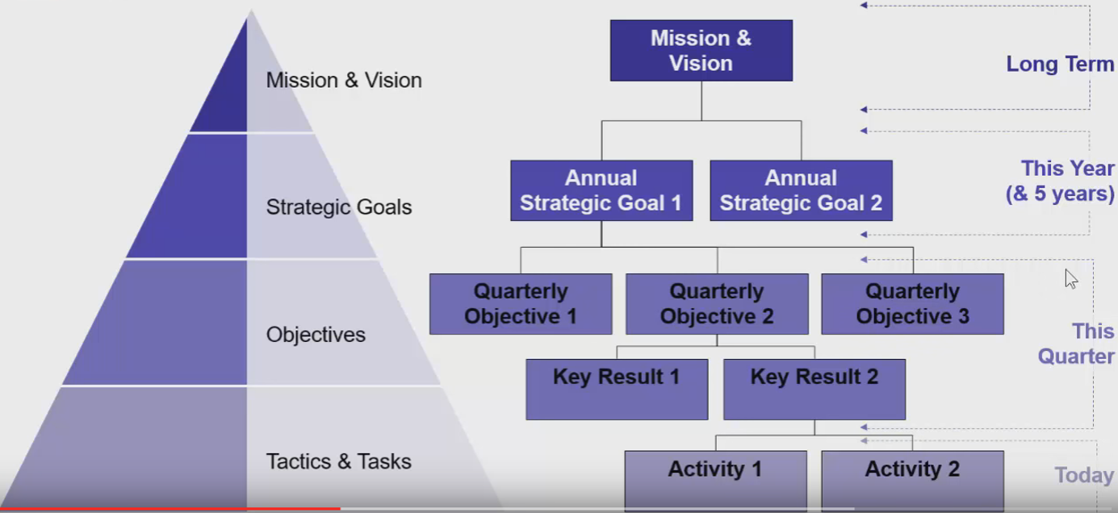
Vision: To be an exciting technology services company that inspires people to embrace innovative technologies that make their working lives more effective and enjoyable.
Mission
To provide our customers with technology that helps them work powerfully and support that requires minimal effort from them
Financial Efficiency & Growth
Customer – Current and New
Operational
People
Financial
Decrease expenses by 5%.
Customer
Increase add-on sales to existing customers by 10%
Operational
Reduce time spent per contract per month by 10%.
People
Attend 1 relevant training course or industry event
100 units of online training courses
Present 2 case studies of incidents or projects that went wrong or right

Slide 11
Project Scope

Slide 12


Usability
Must be intuitive
Must be simple to interpret
A great experience is effortless

Slide 13
Adaptability
Will be developed independently of Neutrino, but will be merged in

Slide 14

Interfaces
Multi-tiered admin section to allow for Directors, Managers and Staff to use the system
Directors set Strategy Goals
Managers set Objectives
Staff set Key Results with Managers
OKRs will be reviewed weekly by all users

Slide 15
Functions
Easy to access past performance
Allow for “journaling” of notes
Notifications based on thresholds: missing targets, success etc.
Emails/text/Teams notifications

Slide 16
Additional Notes

Slide 17

Notes
Documentation & comments are mandatory
Cross check functionality with team members

Slide 18


